Slide 1
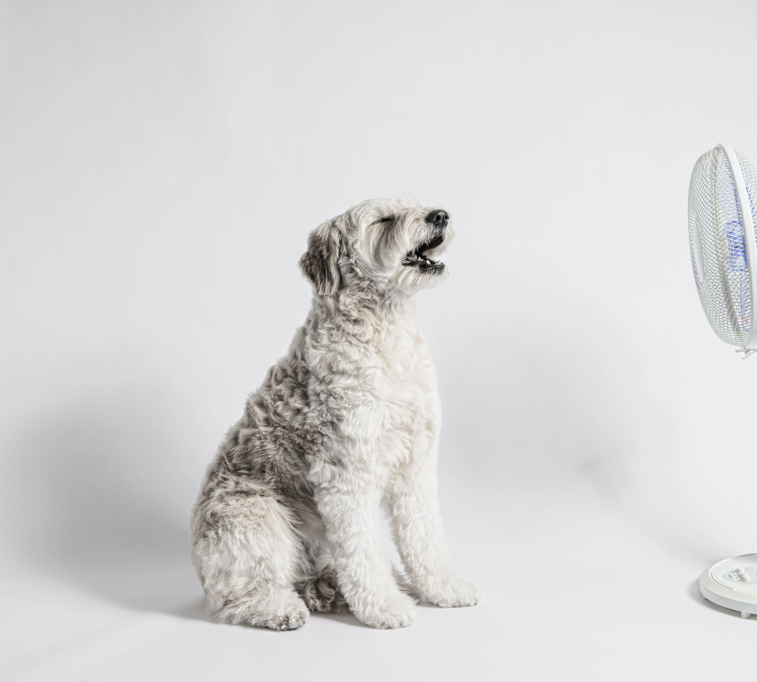
DOG BREED RECOMMENDER SYSTEM
Eric lin

Slide 2
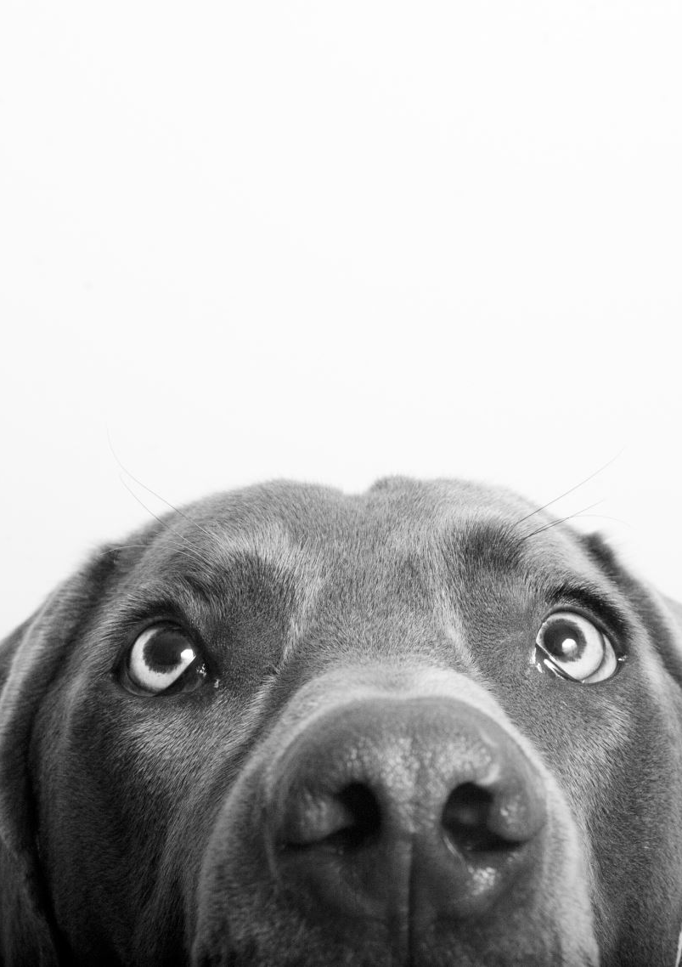
Topic & Objective
Topic
What dog breed is most suitable for you?
Recommendation system based on user preferences
Objective
Create a recommendation system for college students to find a dog breed most suitable for them

Slide 3
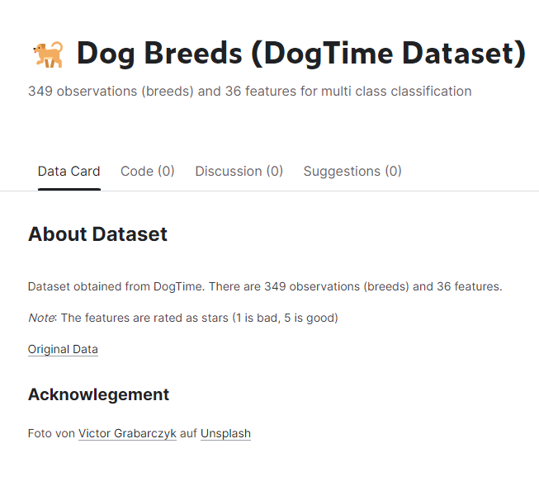
Description of Data
Data is from Kaggle.com
Data includes a variety of dog breed features, ranked from 1-5.
i.e trainability, shedding, barking etc.
Includes data from 349 different breeds

Slide 4
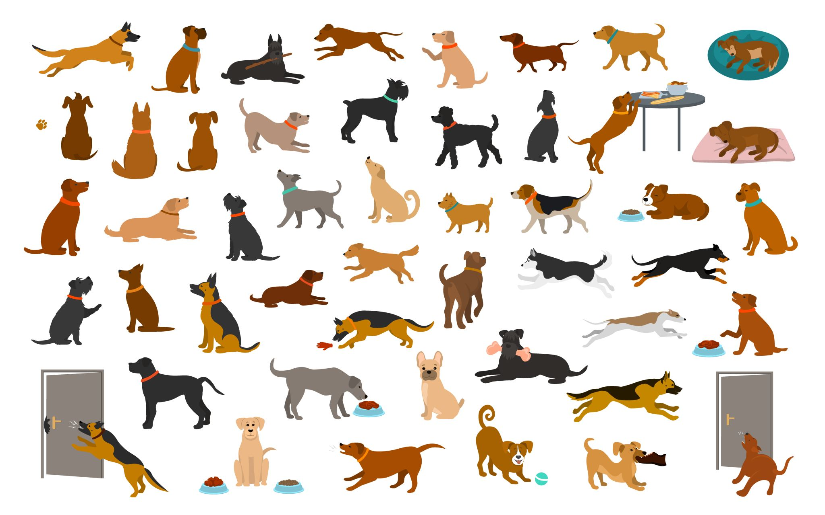
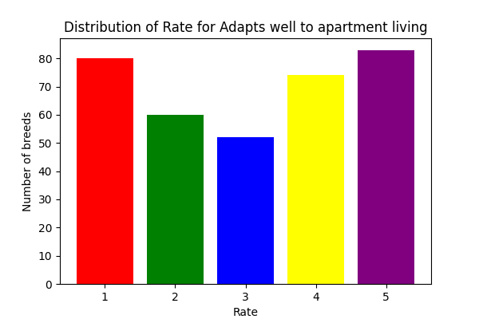
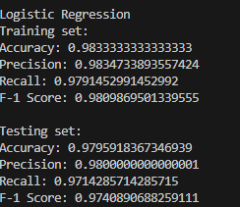

Description of Model
Data Preprocessing:
Processing the dataset by finding and missing values and converting categorical features into numerical ones using label encoding.
Model Training:
Training linear regression, ridge regression, and logistic regression models on the preprocessed data to predict how suitable a dog is for a college student based on various attributes.
Model Evaluation:
Rating the performance of each model using mean absolute error, mean squared error, and root mean squared error.
User Interface:
Providing a user interface where users can select different dog breed and rate their importance. The model then recommends dog breeds based on these ratings and the similarity of their attributes to the user's preferences.

Slide 5
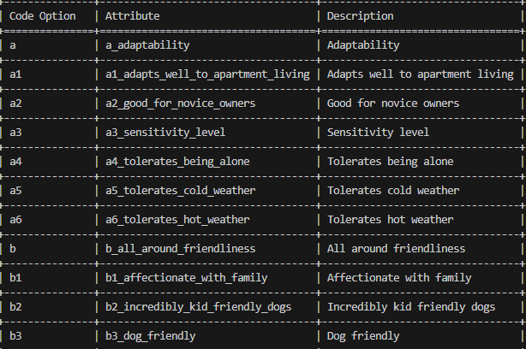
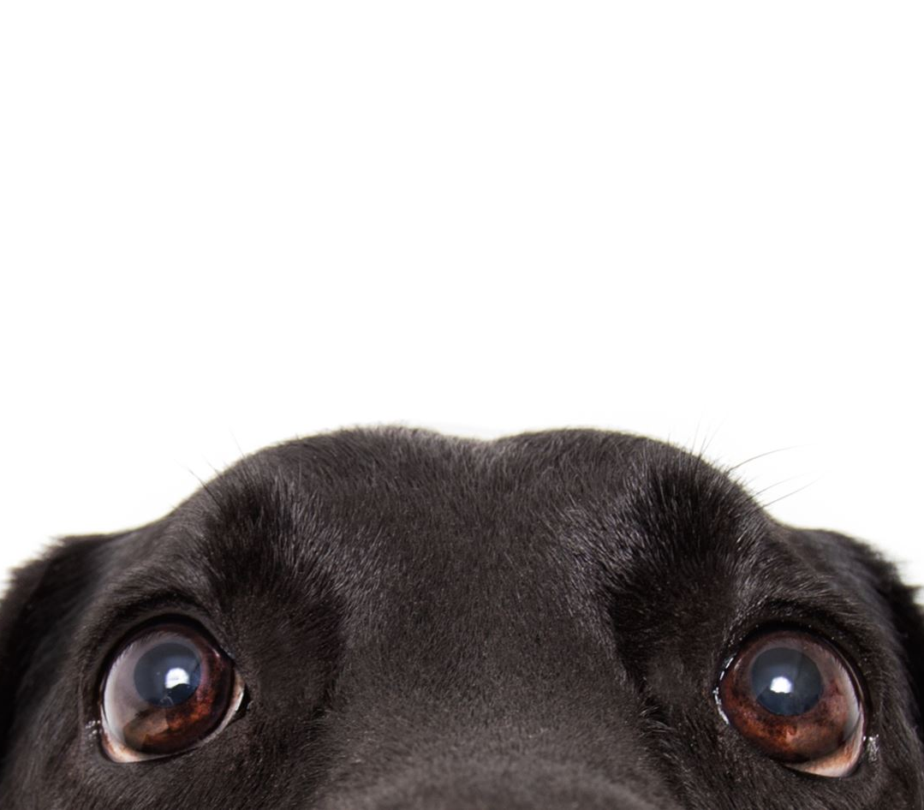
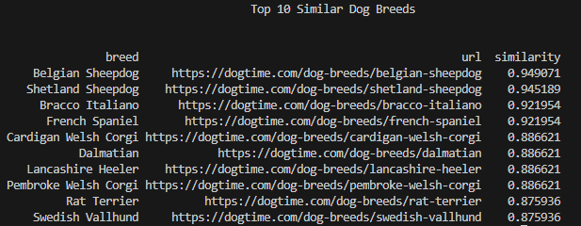
Description of Results
The system works as planned.
User can type in their preferred dog behavior/attributes
The system then produces a list of dog breeds best suited for the user depending on the similarity of what they picked.
The list narrows down if the user selects more preferred attributes.

